Slide 1
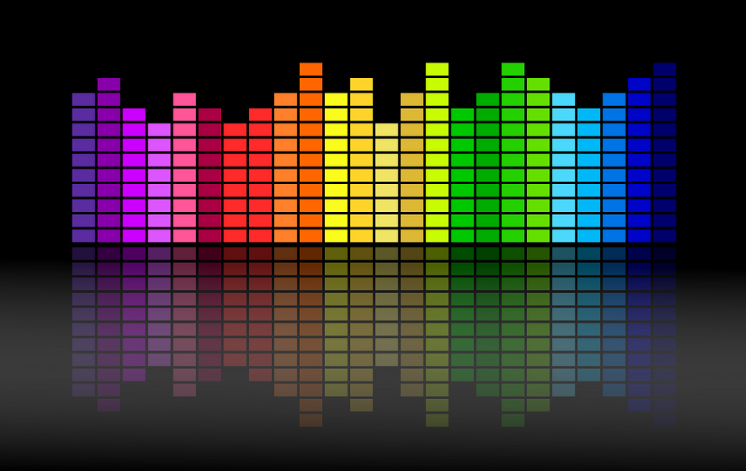

What did the World Listen to in the last Decade Data Research by Spotify and Billboard
2010 - 2019

Slide 2

Spotify and Billboard Researched Data 2010 – 2019
Most Played artist
Most Popular Genre
Popularity Trend, Demographic and Financial Results

Slide 3
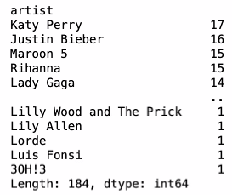
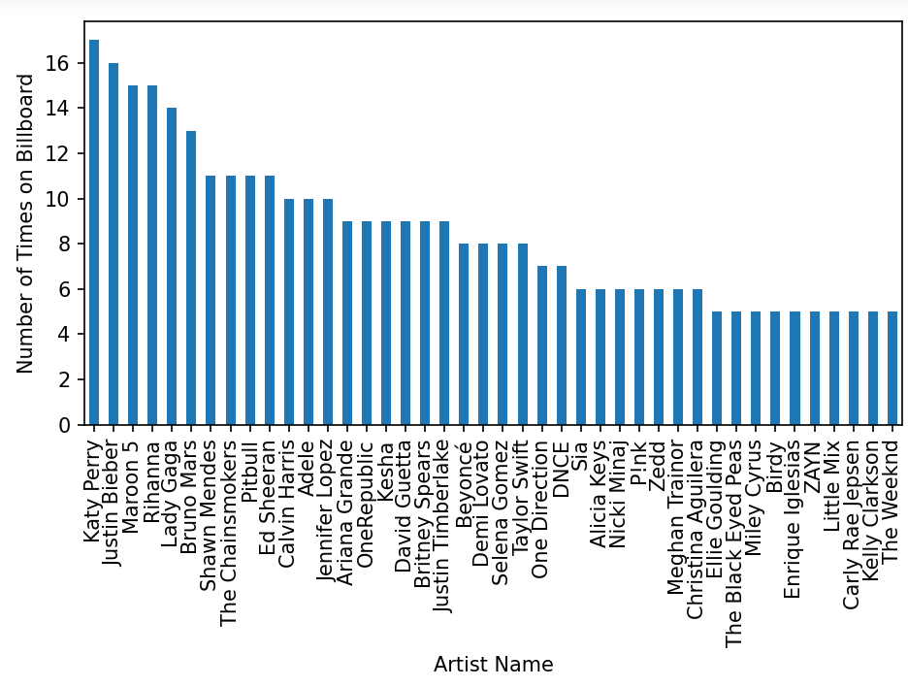
Most Played Artist 2010 -2019
We dove into the newcomers, showstoppers, and top performers who united the globe with music in the last 10 years to analyze which artist is most played.

Slide 4
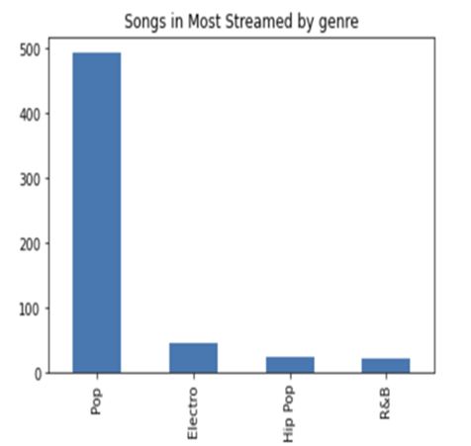
Most Popular Genre 2010 - 2019
When if comes to Popular Genre’s most of these artists have operated through the more traditional avenues of recording blockbuster albums and staging splashy live shows over the past 10 years. We have used data from Spotify to pull together the most played Genre for the last 10 years.

Slide 5
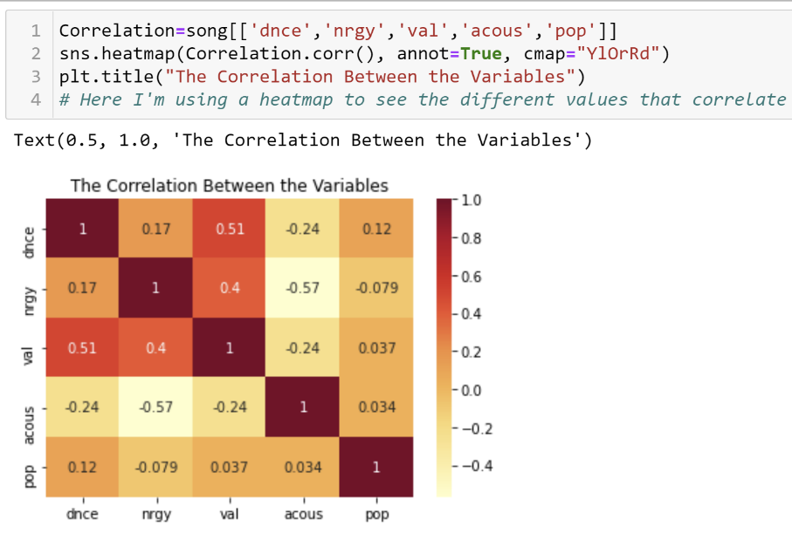
Most Popular Genre 2010 – 2019 (continued)
In our analysis we found no distinct correlation between popularity, danceability, energy and valence.

Slide 6
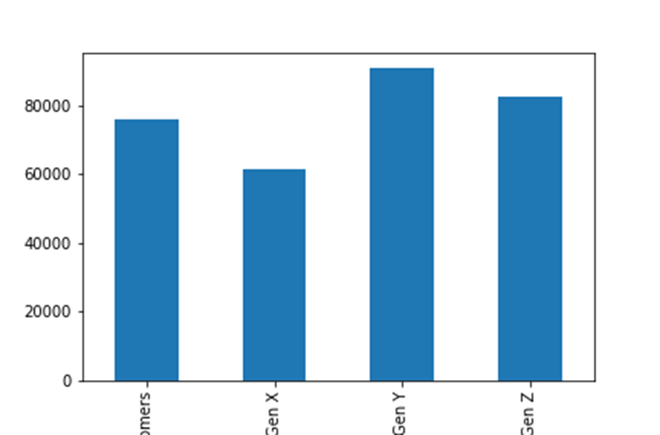
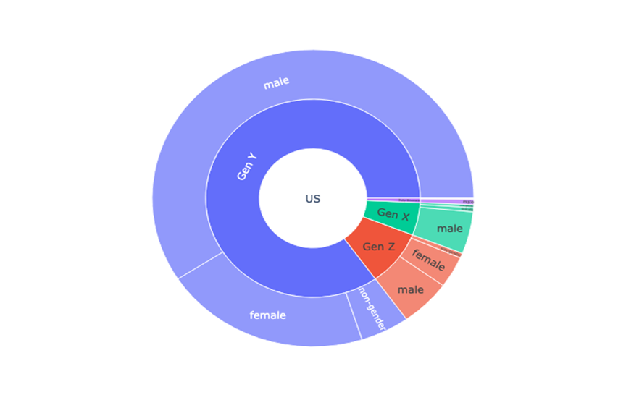
Popularity, Trends and Demographic 2010 -2019
U.S Demographic 2019
Spotify Streaming Demographic
The statistic provides data on Popularity, Trends and Demographics among consumers in the United States from 2010 to 2019.

Slide 7
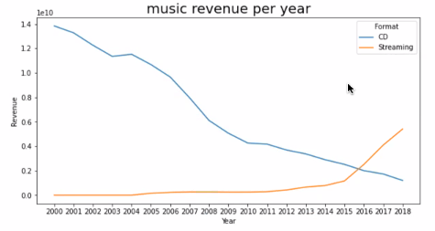
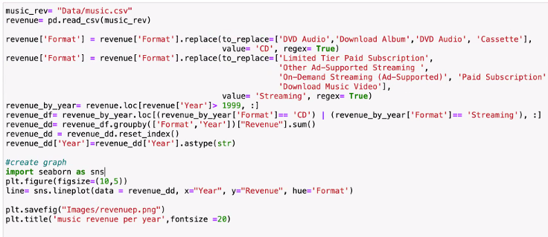
Popularity, Trends and Demographic 2010 -2019

Slide 8

Summary

